Slide 1

Android Physical Input Hijacking
(PHYjacking) Attack Lab
BEACON Labs Workshop - Lab 3
Gaby Dagher, PhD ISPM Research Lab Boise State University
Dylan Gresham ISPM Research Lab Boise State University
Created by: Gunnar Vittrup, ISPM Research Lab
Notes:
Hello and welcome back to Day 2 of the Beacon Labs Workshop. Once again, my name is Dylan Gresham and I’ll be guiding you through this activity today as well.

Slide 2
Source Paper
Title: PHYjacking: Physical Input Hijacking for Zero-Permission Authorization Attacks on Android
Authors: Xianbo Wang et al.
Conference: NDSS
Year: 2022

Slide 3
Preparation
Download starter code for the PHYJacking Activity
Download the Android Studio IDE
Open the Instruction Document
Notes:
First off, if you haven’t already please download the start code, Android Studio, and the instruction document as we will be doing all of our work today within those three resources.

Slide 4
MS - PHYJacking: Overview
Most devices are equipped with one or more of the following: fingerprint sensor, camera, microphone, touch screen
Mislead user
Zero-permission application
“PHYJacking: Physical Input Hijacking for Zero-Permission Authorization Attacks on Android” in the 2021 Network and Distributed System Security Symposium
Notes:
Now as I’m sure you all know, almost all devices nowadays have some sort of physical input mechanism. Could be a fingerprint sensor, a camera, a microphone, or a touch screen. This attack takes advantage of these physical input mechanisms to mislead the user with a zero-permission application. In this lab, we’ll actually be building our own application to perform this attack, hence why this is the only activity we’ll be doing today. This attack was published in a paper from the 2021 Network and Distributed System Security Symposium by four researchers from the Chinese University of Hong Kong who’s names I won’t even try and pronounce as I will absolutely butcher them.
Xianbo Wang
Shangcheng Shi
Yikang Chen
Wing Cheong Lau

Slide 5

MS - PHYJacking: Overview Video
Notes:
Before we really get started, let’s watch the video that Gunnar prepared for us.

Slide 6
MS - PHYJacking: Task Set 1
View Intents
Used to sent the user to another app
Used to navigate between activities within your app
Explicit Intent = exact class name of component
new Intent(getApplicationContext(), Example.class);
Implicit Intent = no class is named, actions
new Intent(Intent.ACTION_VIEW, Uri.parse(url));
Notes:
Thank you Gunnar! Let’s talk a little bit about View Intents. View Intents are used to send the user to another application or to another activity within your own application. There’s two types of intents, explicit and implicit. Explicit intents are mainly used from within your own application as they’re constructed with the exact component you’re sending the user to. The constructor can be read as “I intend to send the user from this application’s context to the context defined by some other class.” Implicit intents on the other hand are used when we don’t know the exact application or if we don’t care what application handles it. The constructor can be read as “I intend to send the user to some type of view at the URL I specify.” We will be using both types of intents in today’s lab.

Slide 7
MS - PHYJacking: Action 1.1.1
Find the package name of the target banking application, create a launch intent using it, and store it within a variable to use later.
Notes:
Time for our first action. From within our project, open up the MainActivity.java file under the raceattack/src/main/java/com/ispm/raceattack directory. Do note that within Android Studio, there will likely be multiple java directories, we’re looking within the one that is not auto generated. It may help if you change the directory view in the file explorer to “Android” instead of “Project.” Anyways, within MainActivity.java, locate the comment for Action 1.1.1 and create a variable storing an Intent to the target banking application. Take 5 minutes to give this a shot and then we’ll meet back up. Just like before, the instruction document contains the bulk of the information for these actions and if there’s any questions feel free to ask.

Slide 8
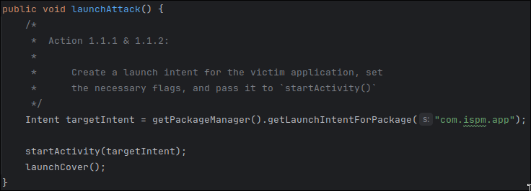
MS - PHYJacking: Action 1.1.1
Find the package name of the target banking application, create a launch intent using it, and store it within a variable to use later.
Notes:
Alright, here’s how I created my implicit intent. I utilized the package manager to automatically build us a launch intent for a specific package, in our case the package is com dot ispm dot app which could be found from looking within the file directory as we do have the source code for the target application in this instance. In the real world, we could get the target application name by utilizing the get installed applications method from the package manager and attempting packages until we find the one we’re looking for.

Slide 9
MS - PHYJacking: Task Set 1
Flags control specific behavior
FLAG_ACTIVITY_NO_ANIMATION
No transition to the next activity state
FLAG_ACTIVITY_NEW_TASK
Start a new task on this history stack
FLAG_ACTIVITY_MULTIPLE_TASK
Create a new task and launch into it
Notes:
Now that we’ve got our target intent, we need to set the proper flags. Since we’re trying to use this app in an attack, we want to make sure that the application opens up quickly and without alarming the user to what we’re doing. To accomplish this, we’re setting three flags which disables the launch animation, creates a new task on the history stack, and then finally creates the actual task and launches it.

Slide 10
MS - PHYJacking: Action 1.1.2
Set the necessary flags on the target application launch intent.
Notes:
Now take the intent that we wrote in Action 1.1.1 and set the appropriate flags on it. Let’s take another five minutes and give that a shot.

Slide 11
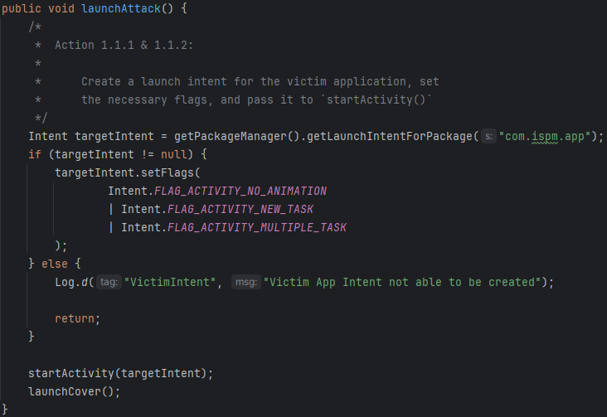
MS - PHYJacking: Action 1.1.2
Set the necessary flags on the target application launch intent.
Notes:
Alright, so here we can see the code that I’ve got. We’re first doing good programming practices and double checking that our target intent was successfully created, if it is, we set our flags using the bitwise OR operator, if it wasn’t successfully created, we write a log message and return early. By catching this early on, we prevent our application from crashing and alerting our victim that there’s something fishy going on.

Slide 12
MS - PHYJacking: Action 1.1.3
Create a launch intent for the covering activity and set the necessary flags.
Notes:
Now we’re going to make one more launch intent. This time in the launch cover function right below the launch attack function where we did our previous two actions. In there, repeat the same two steps we did previously but this time we’re going for our own covering activity which is local to this application and not an external one like the victim app. Let’s take 5 minutes for this and then continue.

Slide 13
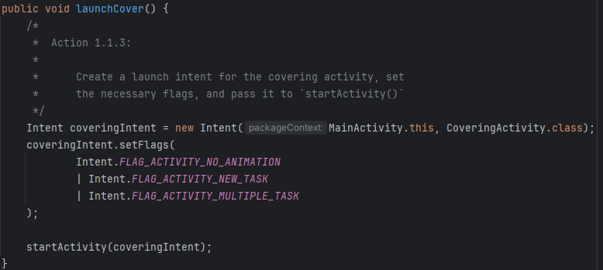
MS - PHYJacking: Action 1.1.3
Create a launch intent for the covering activity and set the necessary flags.
Notes:
Alright, so here I’ve created an explicit intent where we move from this package context to the CoveringActivity context. Since this is an implicit intent, we know that it is guaranteed to work so long as we spelled everything correctly but it may be a good idea to check for null as well. Once we’ve got the intent, we’re setting the same flags and then passing our intent to the start activity function.

Slide 14
MS - PHYJacking: Task Set 1
WindowManager
Manages windows
Flags:
FLAG_NOT_TOUCH_MODAL
Allows pointer events to be sent to the windows behind it
FLAG_NOT_TOUCHABLE
Leaves touches to be handled by a window below this one
Notes:
Now that we’ve got our intents set up and launching in the proper order, we need to setup the window correctly. Since we’re a zero-permission app, we can’t directly modify another app or get any sensitive information. To get around this, we’re not going to ask the user for anything, instead we’re going to trick them into making the transaction themselves. The application that we’re targeting is a fake banking application in which there’s only one path to a successful transaction. We’re going to create an overlay that will guide the user into filling out a “survey” where the buttons follow that single path. To get the user’s input to transfer to the banking application and not our overlay, we need to set two flags on our window manager. The first one allows pointer events to skip our covering activity and be passed to the application behind it and the second tells Android that our application isn’t going to be the one to handle any touch events.

Slide 15
MS - PHYJacking: Action 1.2.1
Set the flags for your covering activity.
Notes:
Now that we’ve gone over the window flags we need, take five minutes to set them from within CoveringActivity.java. That java file can be found in the same directory as MainActivity.java.

Slide 16
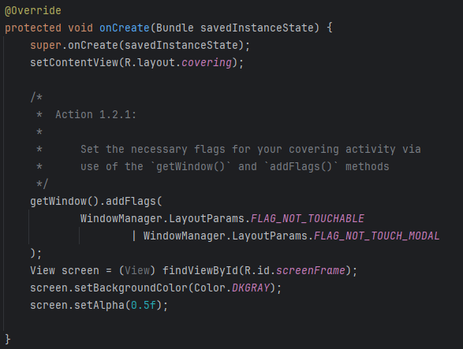
MS - PHYJacking: Action 1.2.1
Set the flags for your covering activity.
Notes:
Alrighty, so here we’ve gotten the window and then just like in the intents, we utilized the bitwise OR operator to set the flags. Within this file, you’ll see some commented out code, we’ll touch more on this later but just know that it will become relevant for us later.

Slide 17
MS - PHYJacking: Task Set 2
onPause( )
Part of the Android App Lifecycle
First indication that user is leaving an activity
Indicates app isn’t in the foreground
Still visible if user is in multi-window mode
Notes:
Now we need to talk a bit about the Android Lifecycle. Since our cover isn’t going to be handling touch events we still need some way of detecting there was a touch, to do so, we will utilize the on pause function event. This event happens every time the user leaves an activity. So, every time the user taps our covering activity, the on pause event gets triggered once the touch goes to the underlying application. Now there is one caveat to this, if the user is in multi-window mode on something like a large-screen TV or maybe a car, the application beneath may still be visible. This is something we would need to keep in mind when picking the target individual for this attack.

Slide 18
MS - PHYJacking: Task Set 2
Tricking the User with an Overlay
Building an overlay
Tricks user into touching the screen where we want them to
If we know the underlying app (target app) then we can make users do things like payments
Notes:
Now we’re at the actual overlay. Everything so far has been the setup for this grand overlay that we’ve been talking about. Now we get to implement it! From within the emulated device, if we open the target application (called “App” on the device) and follow the path defined in the instruction document, we can see where the buttons are on the screen. Those buttons are what we need to trick the user into tapping, in the same order we did to finalize the transaction.

Slide 19
MS - PHYJacking: Action 2.1.1
Create a class and a global variable to keep track of the number of screen transitions.
Notes:
Before we fully jump into the overlay though, we still need to setup the on pause function. First though, we need to create a counter class to keep track of the number of screen pauses. Go ahead and take 5 minutes to create a class file within the same directory as MainActivity and CoveringActivity. Within that class, create a single variable to keep track of the screen count.

Slide 20
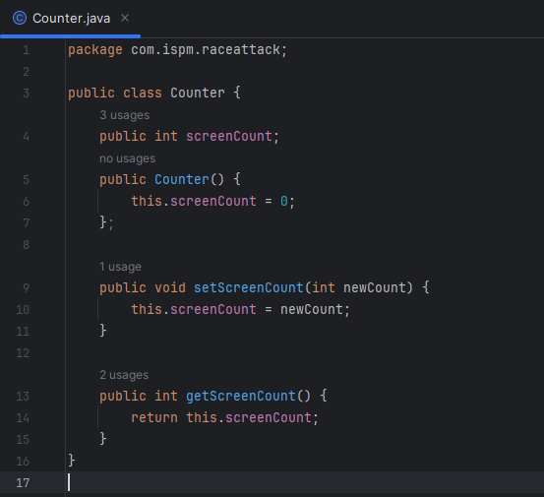
MS - PHYJacking: Action 2.1.1
Create a class and a global variable to keep track of the number of screen transitions.
Notes:
Alright, so here we’ve got our class. Just a straightforward class with a single member variable. Our constructor initializes it to 0 and we have a getter and setter for it.

Slide 21
MS - PHYJacking: Action 2.1.2
Create a static public method that returns your class type called getInstance( ). This method should check to see if your previously created class object is null; if so, it sets instance to a new object, otherwise it simply returns the existing object.
Notes:
Now we need to create a static instance of our class that we can utilize whenever. Create a static instance of our class within our class file as well as a method that returns that instance or creates a new one if it doesn’t already exist. Take 5 minutes to do this.

Slide 22
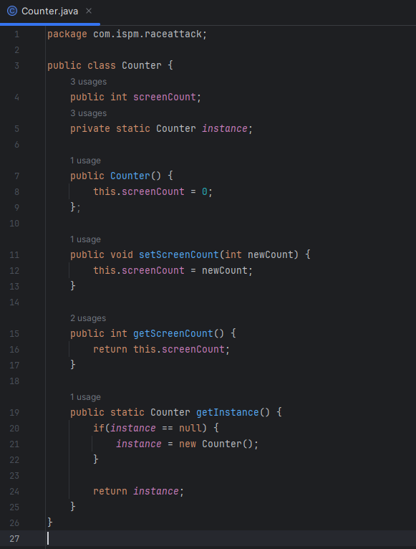
MS - PHYJacking: Action 2.1.2
Create a static public method that returns your class type called getInstance( ). This method should check to see if your previously created class object is null; if so, it sets instance to a new object, otherwise it simply returns the existing object.
Notes:
Here we can see the full class. Just like before we still have our count member and now we have a new member called instance. Notice we’re not initializing it in the constructor since if we initialized it in the constructor it would be overwritten every time a new constructor is made. At the bottom, we’ve got our new get instance function which creates a new instance if it doesn’t already exist and then returns it either way.

Slide 23
MS - PHYJacking: Task Set 2
Logcat
Built into Android Studio
Captures any and all messages from the Log class
Has different log message types:
d - Debug
e - Error
i - Info
v - Verbose
w - Warn
Notes:
We’re almost to the overlay, I promise. Before that I need to officially introduce Logcat. Logcat is an Android Studio built-in feature that sits on top of the Log class in the Android API. Logcat just provides a way for us to quickly see our application logs as well as filter and clear them. There are five different types of log messages we can utilize, debug, error, info, verbose, and warn. Earlier, when we did “Log.d” in Action 1.1.1’s solution, that was utilizing Logcat.

Slide 24
MS - PHYJacking: Action 2.1.3
Update the onPause( ) function in CoveringActivity.java to increment and log the screenCount.
Notes:
Ok, final action before the overlay! In our on pause function, go ahead and increment the screen count of our static instance of our counter class. I like to log this as well so we can verify it’s working. In the real world, definitely don’t log it. Let’s take five minutes for this.

Slide 25
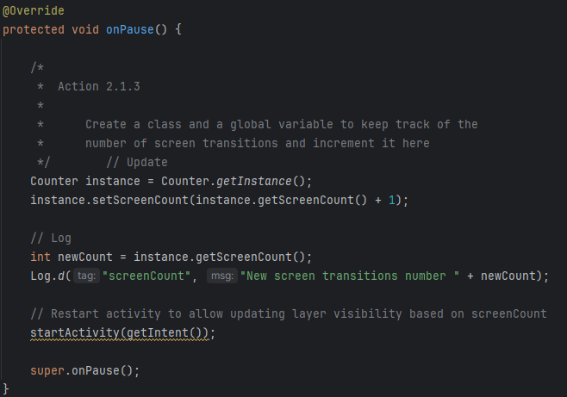
MS - PHYJacking: Action 2.1.3
Update the onPause( ) function in CoveringActivity.java to increment and log the screenCount.
Notes:
Alright, here we can see us doing just that. We first grab our static instance and set the screen count to the current screen count plus 1. I then logged it, which is optional, and then restart the activity before calling the parent on pause method.

Slide 26
MS - PHYJacking: Task Set 2
The Overlay
All UI components are defined in the ‘res’ package
‘res’ standing for resources
Android Studio has a built in layout editor
UI defined in XML
Similar to HTML
Toggle visibility based on the screenCount instead of onClick handlers
Notes:
Now time for the real meat of this: the overlay. This will be the longest part and if you’re unfamiliar with graphical development of any sort, probably the hardest part too. Android Studio has a nice graphical editor built into it. If you navigate to the raceattack/res/layout/covering.xml file, this editor should be automatically opened for you. I recommend using the graphical editor but feel free to toggle to the raw XML in the top left of the editor if you’d like. The “res” folder is where all of the resources for the application live. Unlike web development, Android UI is defined in XML instead of HTML, although they are very similar. For the overlay implementation itself, I will leave it ultimately up to you but I recommend a survey like what will be shown in the next slide. If you recall, I mentioned way back in Action 1.2.1 that there was some commented out code, this is where we’re utilizing it. That code shows an example of how you can access UI components from within Java and perform actions on it. This is how you might toggle visibility.

Slide 27
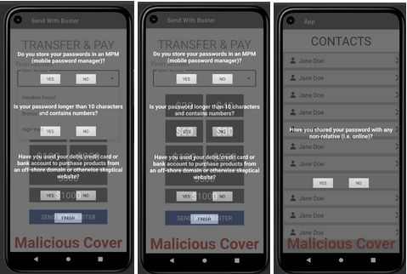
MS - PHYJacking: Action 2.2.1
Create your navigational overlay.
Notes:
Here’s the overlay that I made, going from right to left, we have the user click the contact we need them to, and then they answer each question from top to bottom, for each question, no matter what answer the user chooses, the app will still continue in the way we want it to for the transaction to be made. Feel free to try and copy this layout or to make your own. Take the next 45 minutes to give it a shot and then we’ll reconvene.
Alright, so now that we’ve given it a shot and know what would go into implementing something like this, let’s carry on. After the next Action, there will be a way for everyone to get on the same track.

Slide 28
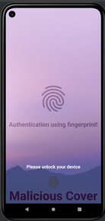
MS - PHYJacking: Action 2.2.2
Create a fake lock-screen for the final destination of your overlay.
Notes:
Now for our final bit of UI development, we need to create a fake lock-screen to get the user to enter their fingerprint to authorize the payment. Take 10 minutes to get this implemented.
If you weren’t able to get a functioning solution, change the directory view from Android to Project and locate the two files called create-bottom and quick. Create bottom contains the Java code and should be placed as the final bit of code under the Action 2.2.1 comment in CoveringActivity.xml. Quick contains the XML code for the layout that I’ve created already. If you replace the content of your covering.xml with the contents of quick, you should have the exact same overlay that I have and the attack should succeed if everything was done properly.

Slide 29

MS - PHYJacking: Task Set 3
Notes:
Before we move on to Game Theory, let’s watch a video from William Spaniel to explain this concept.

Slide 30
MS - PHYJacking: Task Set 3
Our Scenario
App has a ¾ chance of being robust and ¼ chance of being vulnerable
Attacker (Player 1) decides to either attack or not attack the User (Player 2)
The User will decide whether or not to follow the Attacker’s prompts
If the User follows the prompts:
If the app is robust, a security flag will be triggered and the attack fails
If the app is vulnerable, the attack will succeed and the User will be at a big loss
If the User doesn’t follow the prompts, regardless of whether the app is robust or vulnerable, the User fails to notice the malicious app and the Attacker gets to monitor state information of the User’s device, causing a small loss to the User.
Notes:
Thank you Dr. Spaniel, let’s take a look at our specific scenario. We have two players, the attacker who is player one and the user who is player two. The environment in this instance is an application, in which there’s a 75% chance of it being robust and a 25% chance of it being vulnerable. The user will decide on their turn whether or not to follow the attacker’s prompts. If the user does follow the prompts and the app is robust, a security flag will be triggered and that attack fails. If the app is vulnerable though, the attack will succeed and the user will be at a big loss. On the other hand, if the user doesn’t follow the prompts, regardless whether the app is robust or vulnerable, the user will fail to notice the malicious app and the attacker gets to monitor state information of the user’s device, ultimately causing a small loss to the user.

Slide 31
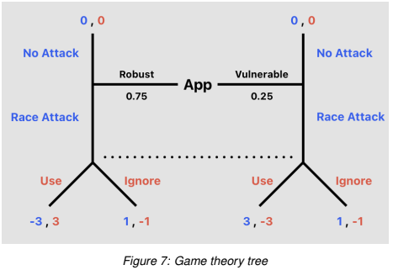
MS - PHYJacking: Task Set 3
Notes:
Here, we can see the scenario represented as a tree instead of a massive wall of text.

Slide 32
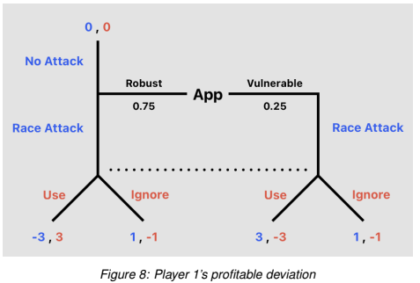
MS - PHYJacking: Task Set 3
Notes:
Since we know that the attacker, who moves first, will never choose NOT to attack a vulnerable app, we can remove the no attack path on the vulnerable side.

Slide 33
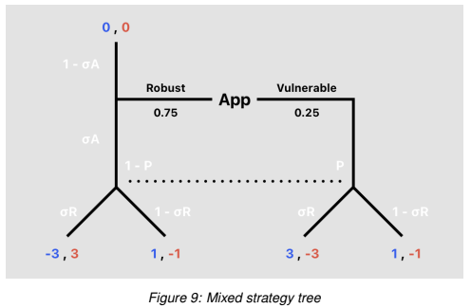
MS - PHYJacking: Task Set 3
Notes:
Now to calculate the user’s mixed strategy, we can parameterize the different paths and use the formulas shown in the video and instruction document to calculate the mixed strategy. I will skip over the math involved in the slides but definitely go over the math while doing the actions.

Slide 34
MS - PHYJacking: Task Set 3
Recap:
Player 1 attacks a robust app with a probability of σ_{A}
After observing Player 1 attack, Player 2 believes that the app is vulnerable with a probability of P
Player 2 then uses the app with a probability of σ_{R}
Notes:
To recap our scenario however, the attacker has a sigma sub a percent chance to attack a robust app. If the user observes the attacker attacking, then the user believes there’s a P percent chance that the app is vulnerable. Finally, we can determine that the user will use the app with a probability of sigma sub r.

Slide 35
MS - PHYJacking: Action 3.1.1
Calculate Player 2’s pooling equilibrium.
Notes:
Go ahead and take the next 15 minutes to calculate the user’s pooling equilibrium. Don’t forget to go over the math in the instruction document as well.

Slide 36

MS - PHYJacking: Action 3.1.1
Calculate Player 2’s pooling equilibrium.
Notes:
Here we can see that we’ve calculated the user’s utility for following the prompts to be 1.5 and ignoring the prompts to be negative one.

Slide 37
MS - PHYJacking: Action 3.1.2
Which strategy profitably deviates?
Notes:
So which strategy profitably deviates? Take 3 minutes to reason this out in your head.

Slide 38
MS - PHYJacking: Action 3.1.2
Which strategy profitably deviates?
The Use strategy profitably deviates because it is 1.5 instead of -1.
Notes:
Alright, well if we simply compare the numbers, we find that the use strategy is the one that profitably deviates as 1.5 is greater than negative one.

Slide 39
MS - PHYJacking: Action 3.1.3
Calculate the value of σ_{R}, which represents Player 2’s mixed equilibrium strategy.
Notes:
No let’s take 10 minutes to calculate the value of sigma sub r, representing the user’s mixed equilibrium strategy.

Slide 40
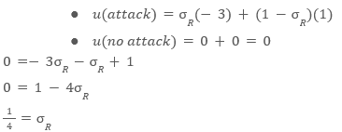
MS - PHYJacking: Action 3.1.3
Calculate the value of σ_{R}, which represents Player 2’s mixed equilibrium strategy.
Notes:
Ok, so from the formulas on the screen, we can calculate the the utility for the user when there is an attack to be -3 sigma sub r plus 1 - sigma sub r. Likewise, the utility for the user if there is no attack is simply 0. We can then do some basic algebra to solve for sigma sub r and find that it’s equal to one quarter or 0.25.

Slide 41
MS - PHYJacking: Action 3.1.4
What is the probability that Player 2 uses the app?
Notes:
So now, how do we interpret that? What’s the probability that the user uses the app? Go ahead and shout it out if you think you’ve got it.

Slide 42
MS - PHYJacking: Action 3.1.4
What is the probability that Player 2 uses the app?
0.25 is the probability that player 2 uses the app.
Notes:
Yup, it’s just the 0.25 we calculated.

Slide 43
MS - PHYJacking: Action 3.1.5
Calculate the value of P, which represents Player 2’s belief that they are facing a vulnerable app.
Notes:
Let’s calculate the probability, P, representing the user’s belief that they’re facing a vulnerable app. In other words, calculate the chance that the user thinks the app is vulnerable. Take 5 minutes for this.

Slide 44
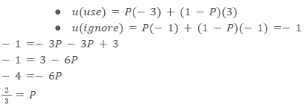
MS - PHYJacking: Action 3.1.5
Calculate the value of P, which represents Player 2’s belief that they are facing a vulnerable app.
Notes:
Similar to calculating the mixed equilibrium, we have our utility functions for following the prompts (use) and ignoring the prompts. We can then set them equal to each other and solve for P and find that P is two thirds.

Slide 45
MS - PHYJacking: Action 3.1.6
Calculate the value of σ_{A}, which represents the probability that the app is robust and Player 1 chooses to attack.
Notes:
Finally, let’s calculate the value of sigma sub a, representing the probability that the app is actually robust and the attacker still chooses to attack. Let’s take 5 minutes for this.

Slide 46

MS - PHYJacking: Action 3.1.6
Calculate the value of σ_{A}, which represents the probability that the app is robust and Player 1 chooses to attack.
Notes:
Ok, so using the formula in the instruction document and plugging in our values, we can find that sigma sub a is one sixth. Meaning, there’s a 16.67% chance that the attacker attacks a robust app.

Slide 47
MS - PHYJacking: Summary
Many mobile apps use physical inputs
Misleading an unsuspecting user
Conventional design patterns that lead to increased security risks
Notes:
So, just to recap. We’ve recognized that nearly all mobile devices nowadays have a physical input of some sort. By misleading a user utilizing built-in, conventional design patterns, we create security risks and ultimately cause some real damage to people.

Slide 48
Questions?
Wrap-up
Notes:
Now that we’ve finished up the lab, are there any questions?

Slide 49
Thank you for participating in this workshop!
BEACON Labs - Workshop
Notes:
Thank you all for participating in this workshop! I hope that everyone was able to learn something new and maybe in the future these labs can be utilized in your classrooms to aide in student learning.

